Slide 1
Мережевий рівень
Роль мережевого рівня в комунікації між мережами
Найпоширеніший мережевий протокол lP (Internet Protocol) та його особливості
Маршрутизація
Маршрутизатори
Конфігурування маршрутизатора

Slide 2
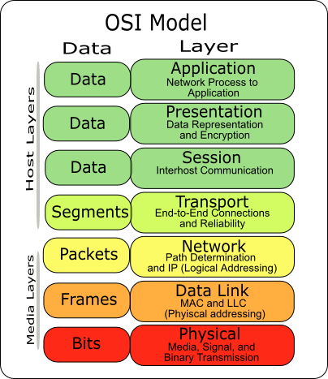
Мережевий рівень
Notes:
Section 6.0

Slide 3
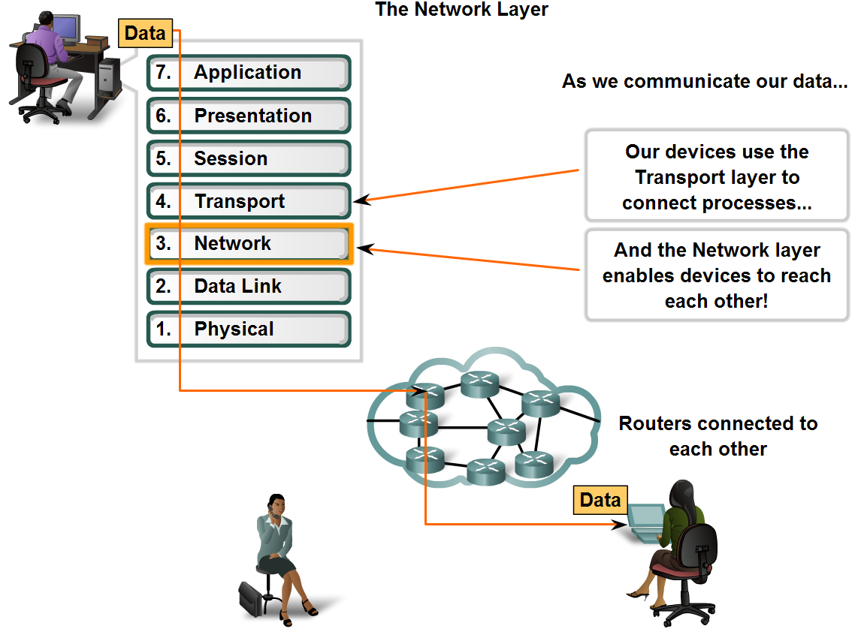
Мережевий рівень та IP протокол
Роль мережевого рівня в мережах передавання даних

Slide 4
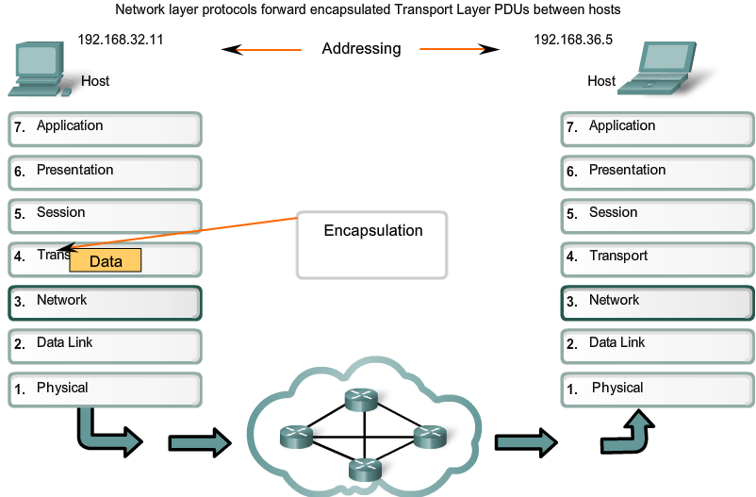
Мережевий рівень та IP протокол
Мережевий рівень використовує 4 основні процеси:
- адресацію;
- інкапсуляцію;
- маршрутизацію;
- деінкапсуляцію.

Slide 5
Протоколи мережевого рівня
Діючі протоколи
Internet Protocol version 4 (IPv4)
Internet Protocol version 6 (IPv6)
Застарілі протоколи
Novell Internetwork Packet Exchange (IPX)
AppleTalk
Connectionless Network Service (CLNS/DECNet)
Notes:
Section 6.1.1.2

Slide 6
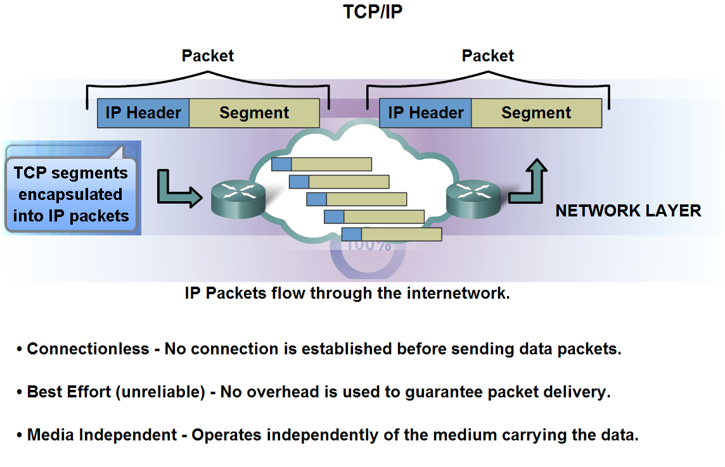
Мережевий рівень та IP протокол
Роль протоколу IPv4

Slide 7
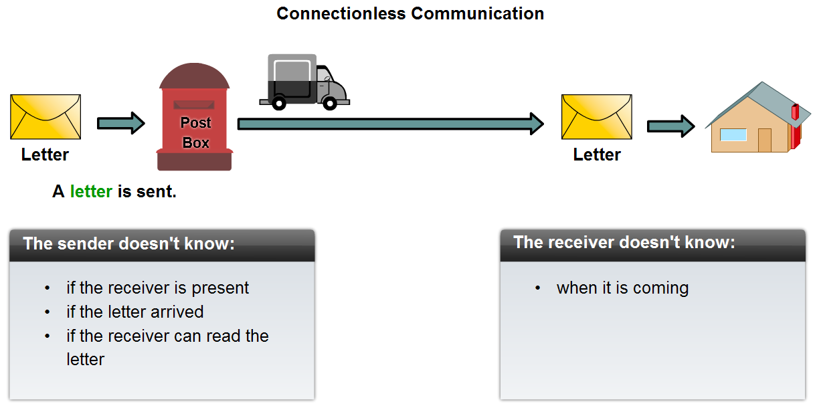
Мережевий рівень та IP протокол
IP протокол – протокол без встановлення з’єднання

Slide 8
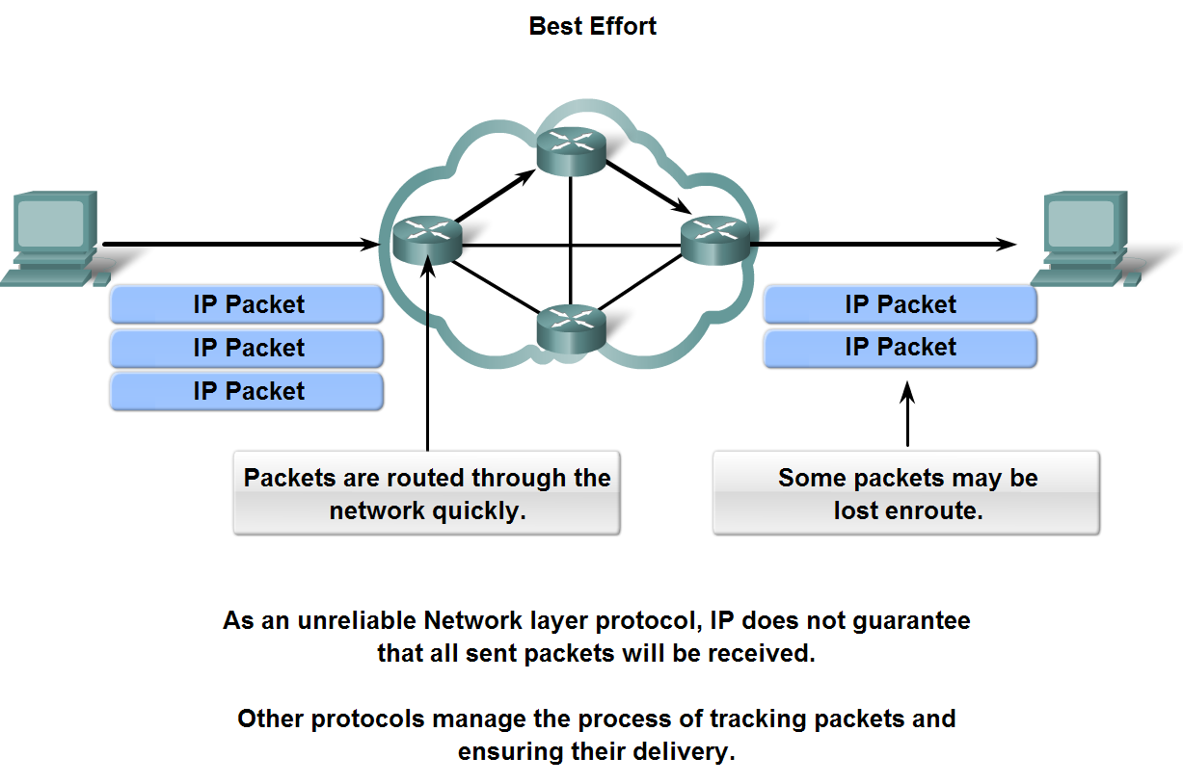
Мережевий рівень та IP протокол
IP протокол – не надійний протокол

Slide 9
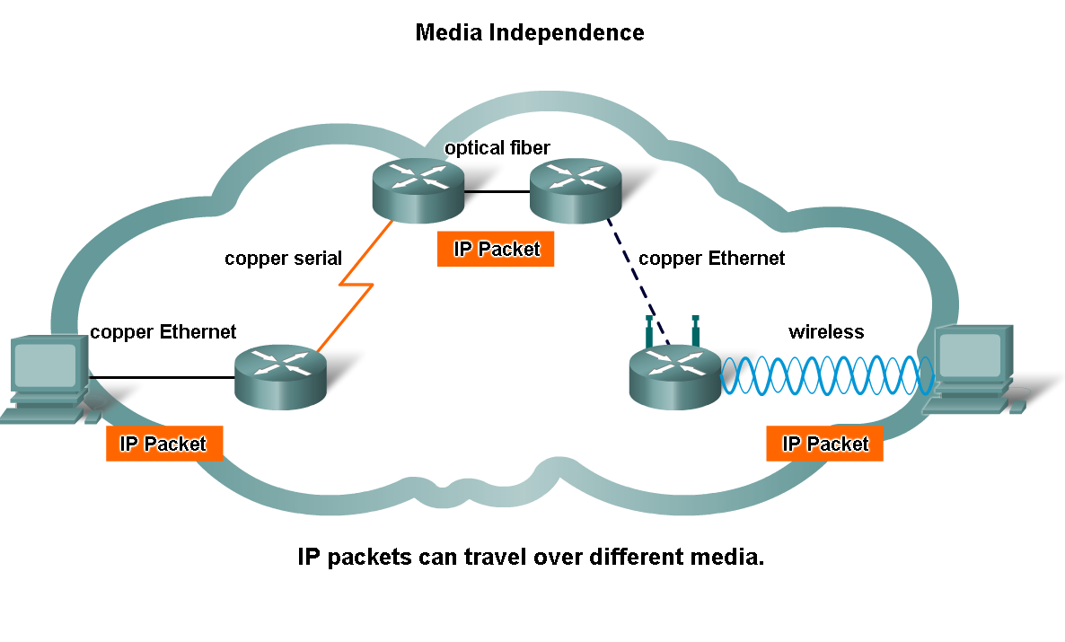
Мережевий рівень та IP протокол
IP протокол – незалежний від середовища передачі

Slide 10
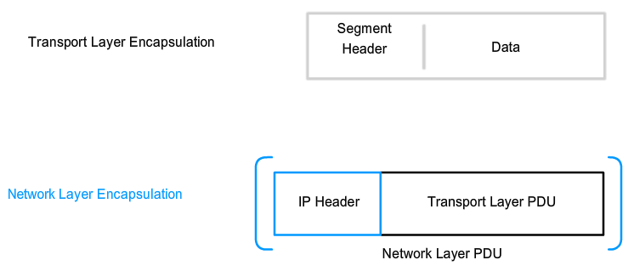
Мережевий рівень та IP протокол
Структура ІР пакету використовується для інкапсуляції датаграм UDP або TCP сегментів для їх передачі між мережами

Slide 11
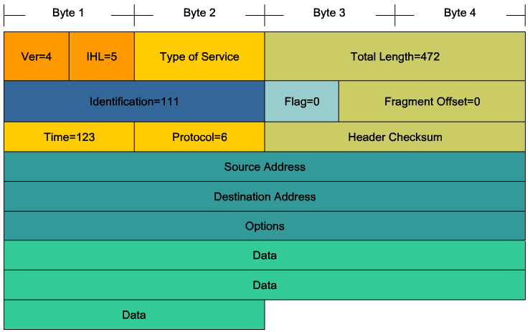
Мережевий рівень та IP протокол
Пакет IPv4

Slide 12
Заголовок пакету IPv4
Version, Differentiated Services (DS), Time-to-Live (TTL),Protocol, Source IP Address, Destination IP Address
Version | IP Header Length | Differentiated Services |  | Total Length
 |  | DSCP | ECN
Identification |  |  |  | Flag | Fragment Offset
Time To Live |  | Protocol |  | Header Checksum
Source IP Address
Destination IP Address
Options (optional) |  |  |  |  |  |  | Padding
Byte 1
Byte 2
Byte 3
Byte 4
Notes:
Section 6.1.3.2

Slide 13
Поля заголовку IPv4
Internet Header Length (IHL), Total Length, Header Checksum, Identification, Flags, Fragment Offset
Version | IP Header Length | Differentiated Services |  | Total Length
 |  | DSCP | ECN
Identification |  |  |  | Flag | Fragment Offset
Time To Live |  | Protocol |  | Header Checksum
Source IP Address
Destination IP Address
Options (optional) |  |  |  |  |  |  | Padding
Byte 1
Byte 2
Byte 3
Byte 4
Notes:
Section 6.1.3.3

Slide 14
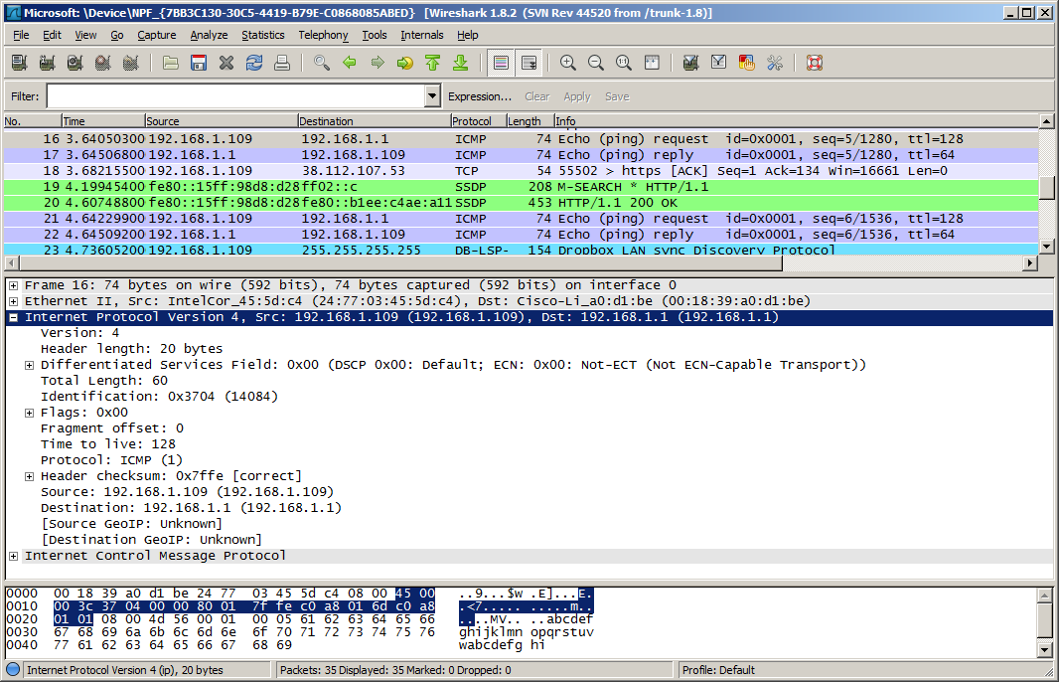
Приклад заголовку IPv4
Notes:
Section 6.1.3.4

Slide 15

Обмеження протоколу IPv4
Недостатня кількість IP-адрес
Розширення Інтернет таблиці маршрутизації
Відсутність зв'язку з кінця в кінець
Notes:
Section 6.1.4.1

Slide 16
Network Layer in Communication Introducing IPv6
Increased address space
Improved packet handling
Eliminates the need for NAT
Integrated security
4 billion IPv4 addresses 4,000,000,000
340 undecillion IPv6 addresses 340,000,000,000,000,000,000,000,000,000,000,000,000
Notes:
Section 6.1.4.2

Slide 17
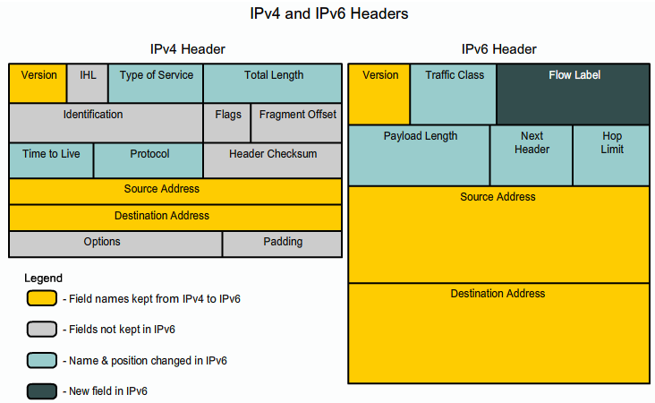
IPv6 Packet Encapsulating IPv6
Notes:
Section 6.1.4.3

Slide 18
IPv6 Packet IPv6 Packet Header
Version | Traffic Class |  | Flow Label
Payload Length |  |  |  | Next Header | Hop Limit
Source IP Address
Destination IP Address
Byte 1
Byte 2
Byte 3
Byte 4
Notes:
Section 6.1.4.4

Slide 19
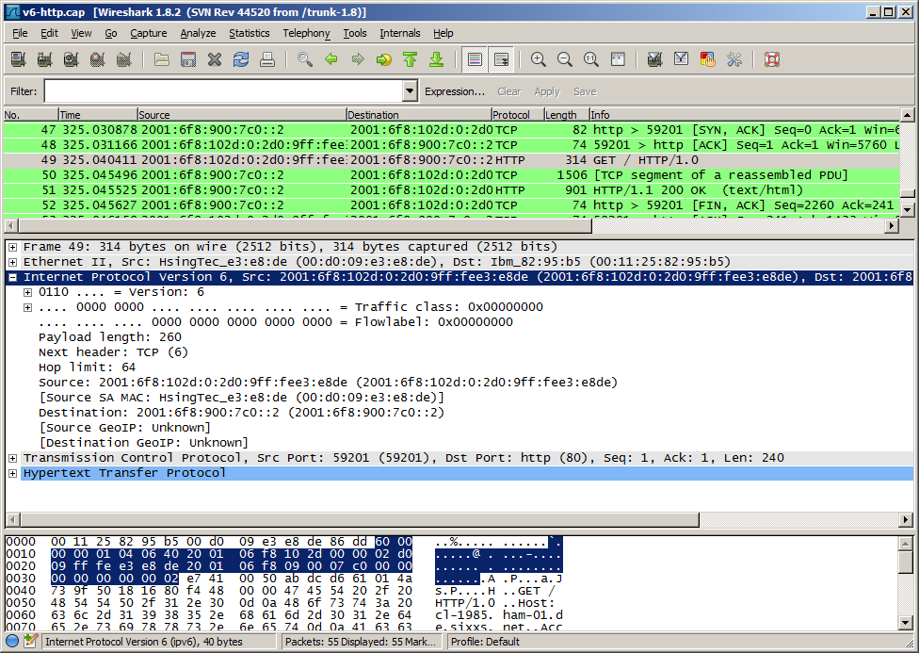
IPv6 Packet Sample IPv6 Header
Notes:
Section 6.1.4.3

Slide 20
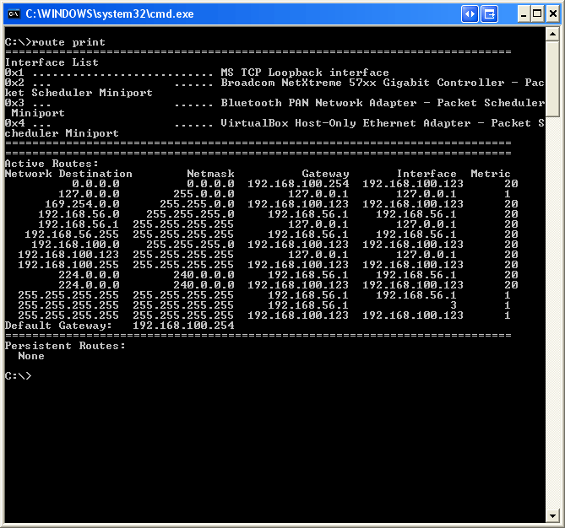
Routing Host Routing Tables
Notes:
Section 6.2.1

Slide 21
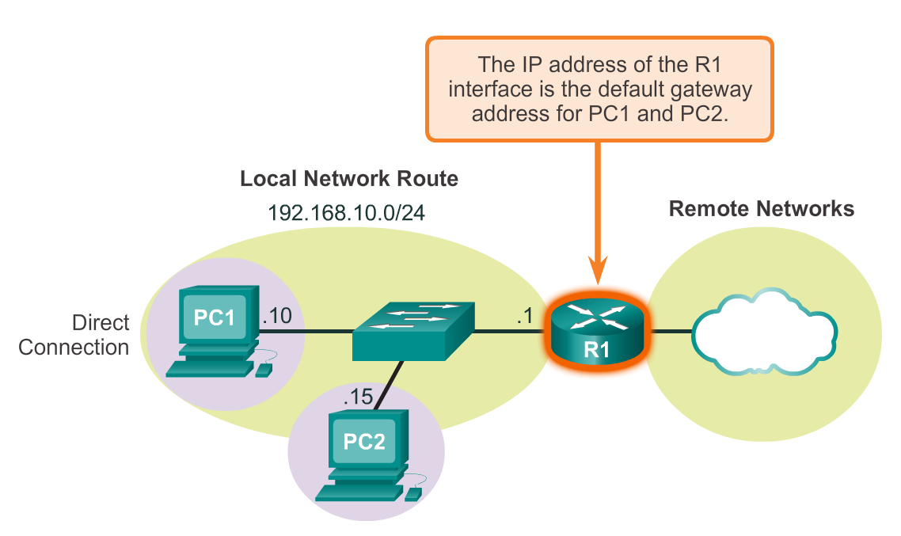
Host Routing Tables Host Packet Forwarding Decision
Notes:
Section 6.2.1.1

Slide 22
Host Routing Tables Default Gateway
Hosts must maintain their own, local, routing table to ensure that network layer packets are directed to the correct destination network. The local table of the host typically contains:
Direct connection
Local network route
Local default route
R
Notes:
Section 6.2.1.2

Slide 23
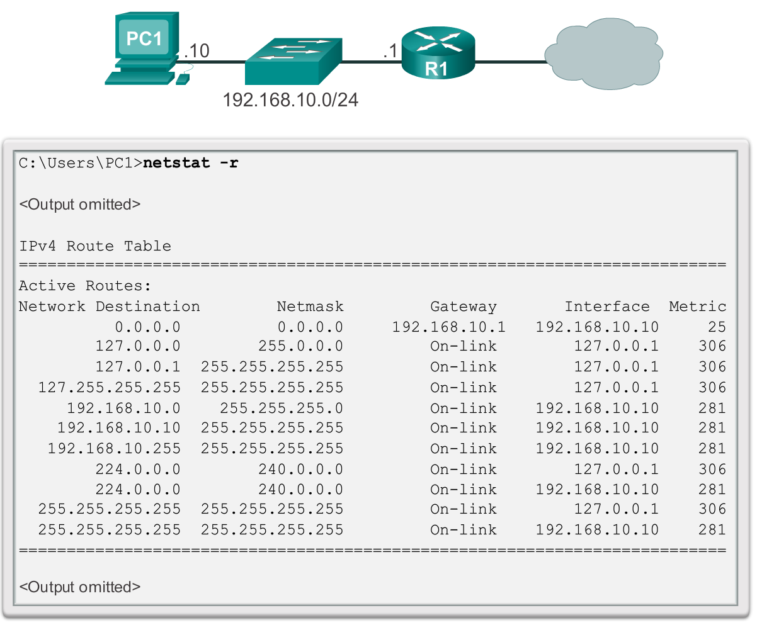
Host Routing Tables IPv4 Host Routing Table
Notes:
Section 6.2.1.3 6.2.1.4

Slide 24
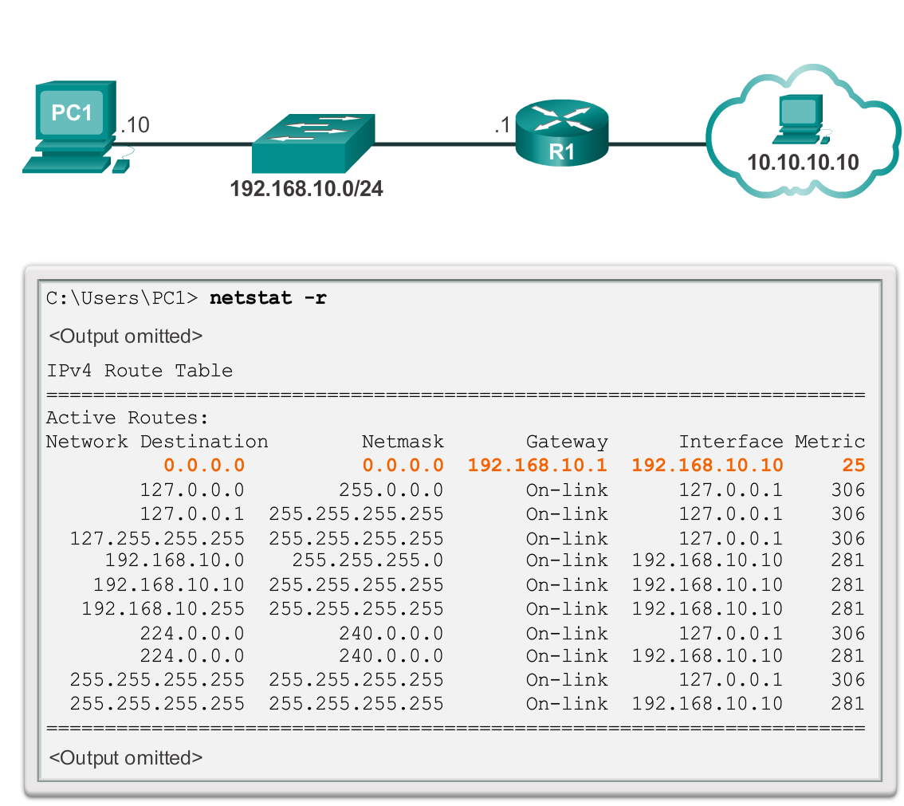
Host Routing Tables Sample IPv4 Host Routing Table
Notes:
Section 6.2.1.5

Slide 25
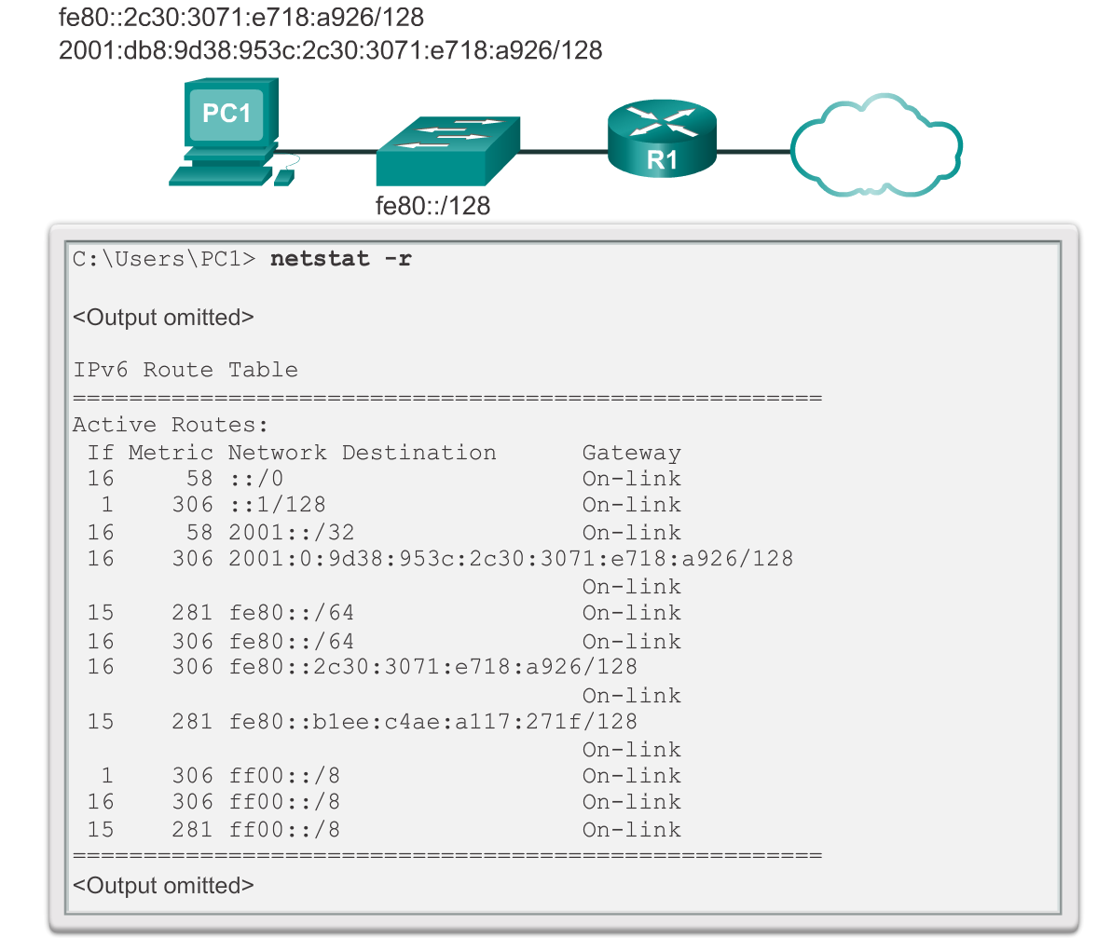
Host Routing Tables Sample IPv6 Host Routing Table
Notes:
Section 6.2.1.6

Slide 26
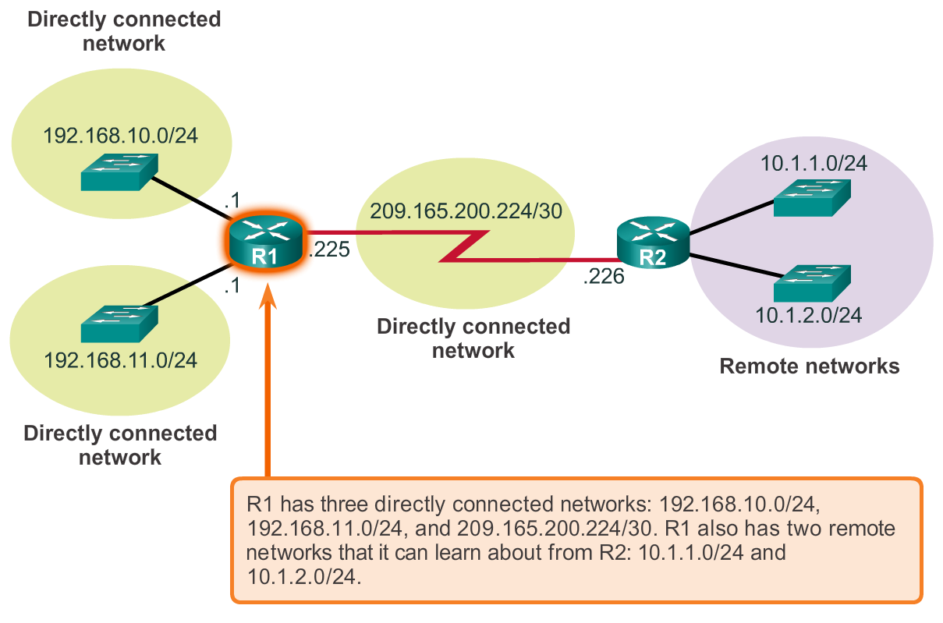
Router Routing Tables Router Packet Forwarding Decision
Notes:
Section 6.2.2.1

Slide 27
Router Routing Tables IPv4 Router Routing Table
192.168.10.0/24
10.1.1.0/24
PC1
.10
G0/0
.1
209.165.200.224 /30
.10
.1
R1
.225
S0/0/0
.226
R2
.10
.1
G0/1
.1
.10
PC2
192.168.11.0/24
10.1.2.0/24
R1#show ip route
Codes: L - local, C - connected, S - static, R - RIP, M - mobile, B - BGP
D - EIGRP, EX - EIGRP external, O - OSPF, IA - OSPF inter area
N1 - OSPF NSSA external type 1, N2 - OSPF NSSA external type 2
E1 - OSPF external type 1, E2 - OSPF external type 2, E - EGP
i - IS-IS, L1 - IS-IS level-1, L2 - IS-IS level-2, ia - IS-IS inter area
* - candidate default, U - per-user static route, o - ODR
P - periodic downloaded static route
Gateway of last resort is not set
10.0.0.0/8 is variably subnetted, 2 subnets, 2 masks
D 10.1.1.0/24 [90/2170112] via 209.165.200.226, 00:00:05, Serial0/0/0
D 10.1.2.0/24 [90/2170112] via 209.165.200.226, 00:00:05, Serial0/0/0
192.168.10.0/24 is variably subnetted, 2 subnets, 3 masks
C 192.168.10.0/24 is directly connected, GigabitEthernet0/0
L 192.168.10.1/32 is directly connected, GigabitEthernet0/0
192.168.11.0/24 is variably subnetted, 2 subnets, 3 masks
C 192.168.11.0/24 is directly connected, GigabitEthernet0/1
L 192.168.11.1/32 is directly connected, GigabitEthernet0/1
209.165.200.0/24 is variably subnetted, 2 subnets, 3 masks
C 209.165.200.224/30 is directly connected, Serial0/0/0
L 209.165.200.225/32 is directly connected, Serial0/0/0
R1#
Notes:
Section 6.2.2.2

Slide 28
Router Routing Tables Directly Connected Routing Table Entries
192.168.10.0/24
64.100.0.1
10.1.1.0/24
PC1
.10
G0/0
.1
209.165.200.224 /30
.10
.1
R1
.225
S0/0/0
.226
R2
.10
.1
G0/1
.1
.10
PC2
192.168.11.0/24
10.1.2.0/24
A
B
C
C 192.168.10.0/24 is directly connected, GigabitEthernet0/0
L 192.168.10.1/32 is directly connected, GigabitEthernet0/0
A | Identifies how the network was learned by the router.
B | Identifies the destination network and how it is connected.
C | Identifies the interface on the router connected to the destination network.
Notes:
Section 6.2.2.3

Slide 29
Router Routing Tables Remote Network Routing Table Entries
192.168.10.0/24
64.100.0.1
10.1.1.0/24
PC1
.10
G0/0
.1
209.165.200.224 /30
.10
.1
R1
.225
S0/0/0
.226
R2
.10
.1
G0/1
.1
.10
PC2
192.168.11.0/24
10.1.2.0/24
D 10.1.1.0/24 [90/2170112] via 209.165.200.226, 00:00:05, Serial0/0/0
A | Identifies how the network was learned by the router.
B | Identifies the destination network.
C | Identifies the administrative distance (trustworthiness) of the route source.
D | Identifies the metric to reach the remote network.
E | Identifies the next hop IP address to reach the remote network.
F | Identifies the amount of elapsed time since the network was discovered.
G | Identifies the outgoing interface on the router to reach the destination network.
Notes:
Section 6.2.2.4

Slide 30
Router Routing Tables Next-Hop Address
192.168.10.0/24
64.100.0.1
10.1.1.0/24
PC1
.10
G0/0
.1
209.165.200.224 /30
.10
.1
R1
.225
S0/0/0
.226
R2
.10
.1
G0/1
.1
.10
PC2
192.168.11.0/24
10.1.2.0/24
R1#show ip route
Codes: L - local, C - connected, S - static, R - RIP, M - mobile, B - BGP
D - EIGRP, EX - EIGRP external, O - OSPF, IA - OSPF inter area
N1 - OSPF NSSA external type 1, N2 - OSPF NSSA external type 2
E1 - OSPF external type 1, E2 - OSPF external type 2, E - EGP
i - IS-IS, L1 - IS-IS level-1, L2 - IS-IS level-2, ia - IS-IS inter area
* - candidate default, U - per-user static route, o - ODR
P - periodic downloaded static route
Gateway of last resort is not set
10.0.0.0/8 is variably subnetted, 2 subnets, 2 masks
D 10.1.1.0/24 [90/2170112] via 209.165.200.226, 00:00:05, Serial0/0/0
D 10.1.2.0/24 [90/2170112] via 209.165.200.226, 00:00:05, Serial0/0/0
192.168.10.0/24 is variably subnetted, 2 subnets, 3 masks
C 192.168.10.0/24 is directly connected, GigabitEthernet0/0
L 192.168.10.1/32 is directly connected, GigabitEthernet0/0
192.168.11.0/24 is variably subnetted, 2 subnets, 3 masks
C 192.168.11.0/24 is directly connected, GigabitEthernet0/1
L 192.168.11.1/32 is directly connected, GigabitEthernet0/1
209.165.200.0/24 is variably subnetted, 2 subnets, 3 masks
C 209.165.200.224/30 is directly connected, Serial0/0/0
L 209.165.200.225/32 is directly connected, Serial0/0/0
R1#
Notes:
Section 6.2.2.5

Slide 31
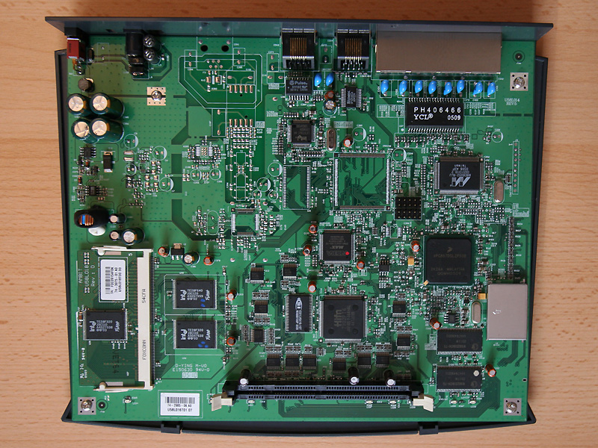
Routers Anatomy of a Router
Notes:
Section 6.3.1

Slide 32
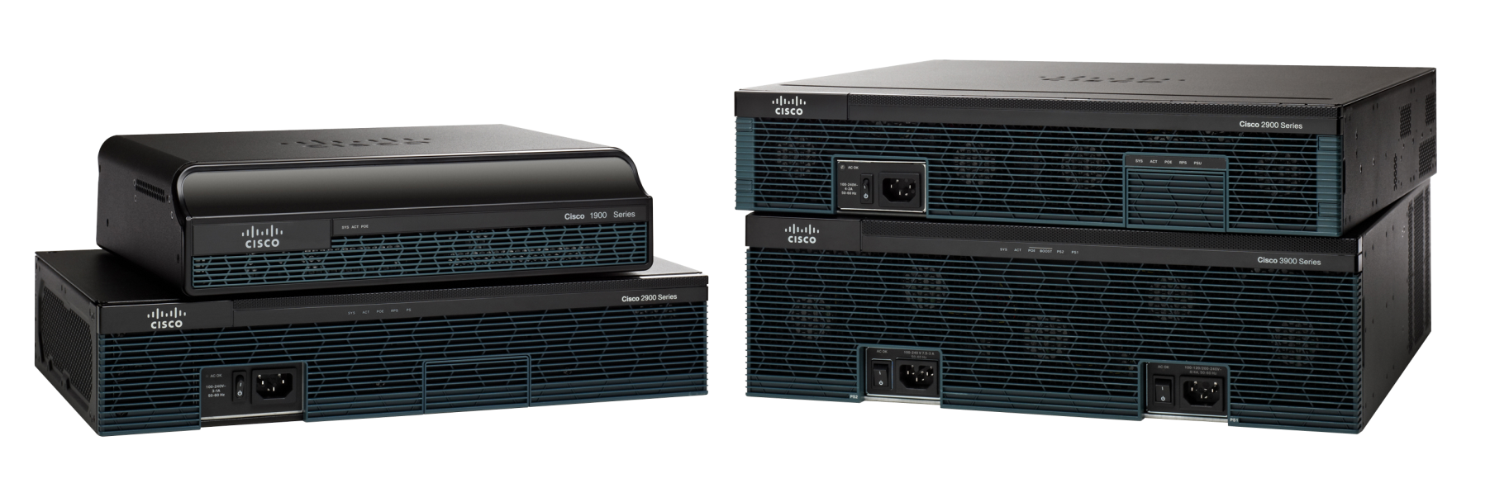
Anatomy of a Router A Router is a Computer
Notes:
Section 6.3.1.1

Slide 33
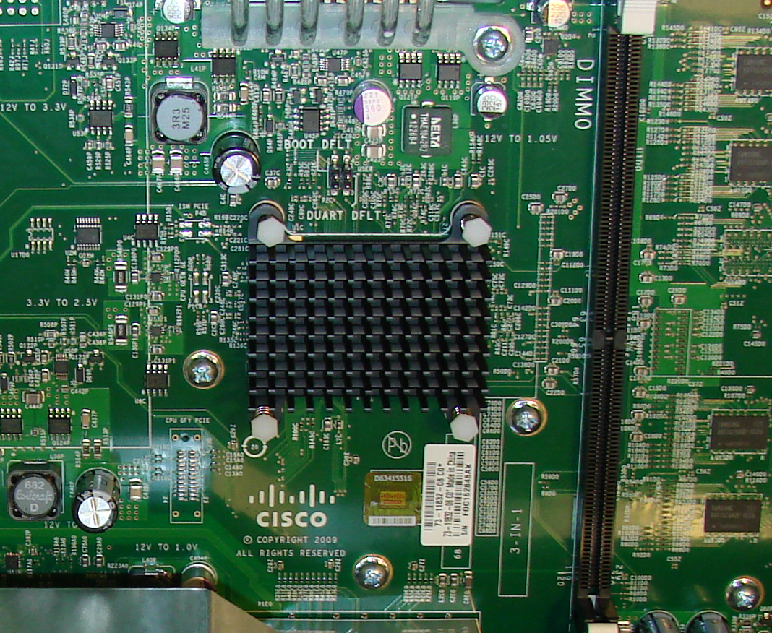
Anatomy of a Router Router CPU and OS
Notes:
Section 6.3.1.2

Slide 34
Anatomy of a Router Router Memory
Memory | Volatile / Non-Volatile | Stores
RAM | Volatile | Running IOS Running configuration file IP routing and ARP tables Packet buffer
ROM | Non-Volatile | Bootup instructions Basic diagnostic software Limited IOS
NVRAM | Non-Volatile | Startup configuration file
Flash | Non-Volatile | IOS Other system files
Notes:
Section 6.3.1.3

Slide 35
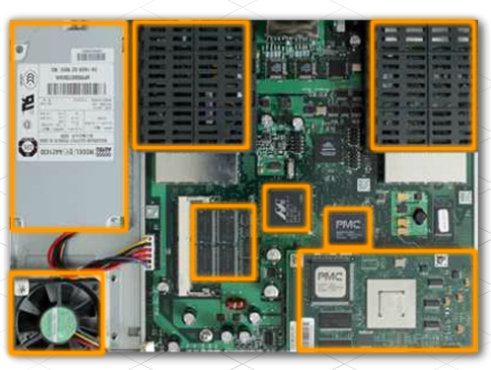
Anatomy of a Router Inside a Router
Notes:
Section 6.3.1.4

Slide 36
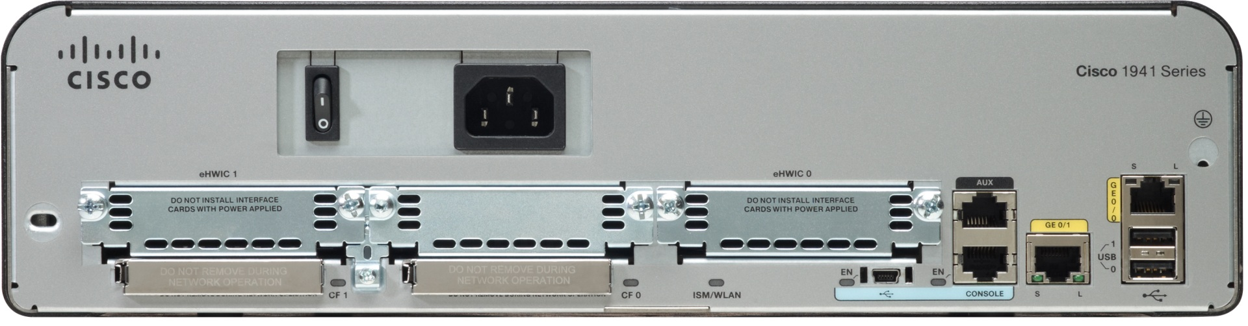
Anatomy of a Router Router Backplane
Double-wide eHWIC slots
eHWIC 0
AUX
port
LAN
interfaces
Console RJ45
USB
Ports
Two 4 GB flash card slots
Console
USB Type B
Notes:
Section 6.3.1.5

Slide 37
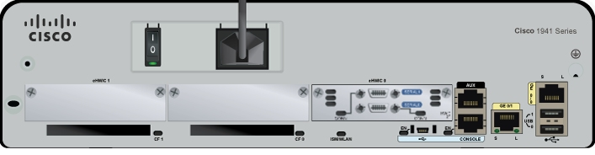
Anatomy of a Router Connecting to a Router
WAN
Interface
AUX
port
LAN
interfaces
Console RJ45
Console
USB Type B
Notes:
Section 6.3.1.6

Slide 38
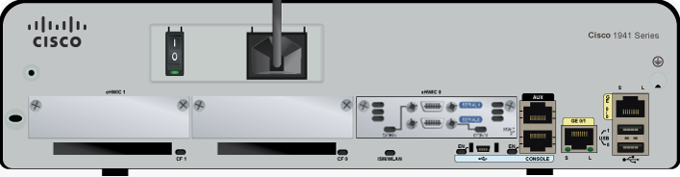
Anatomy of a Router LAN and WAN Interfaces
Serial interfaces
LAN interfaces
Notes:
Section 6.3.1.7

Slide 39
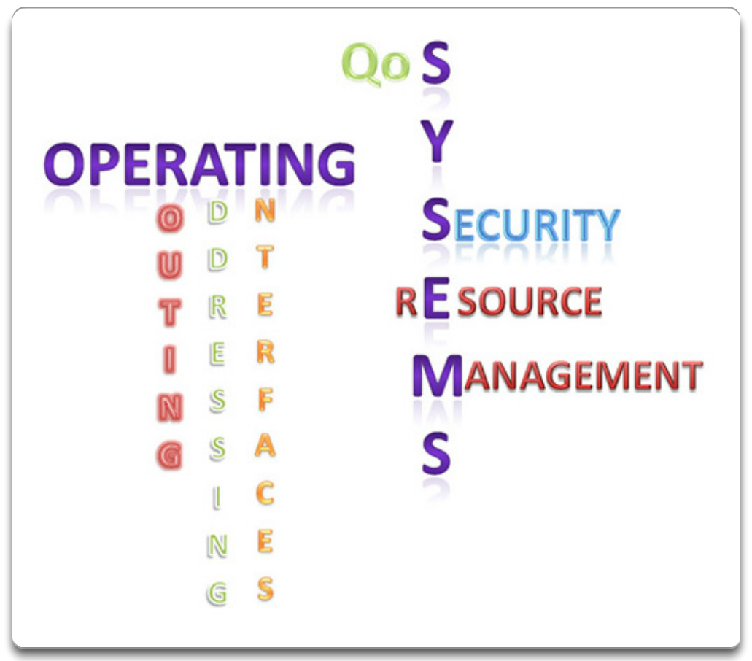
Router Boot-up Cisco IOS
Notes:
Section 6.3.2.1

Slide 40
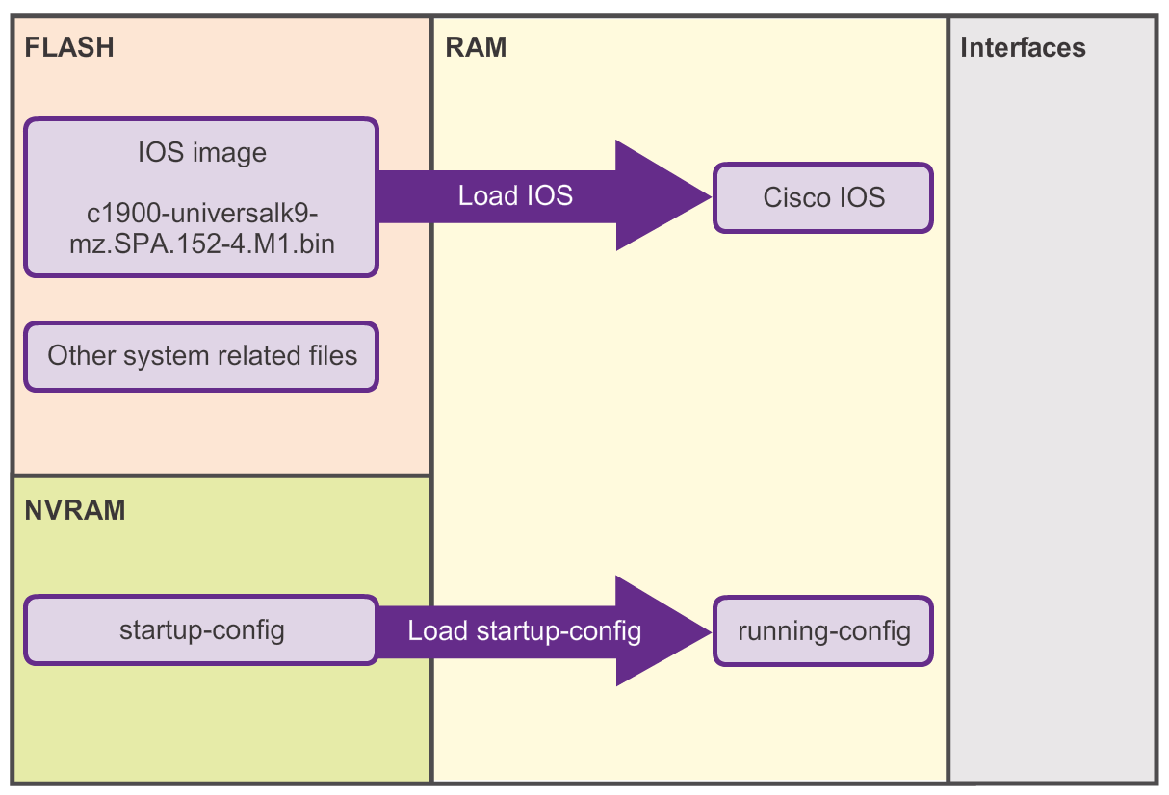
Router Boot-up Bootset Files
Notes:
Section 6.3.2.2

Slide 41
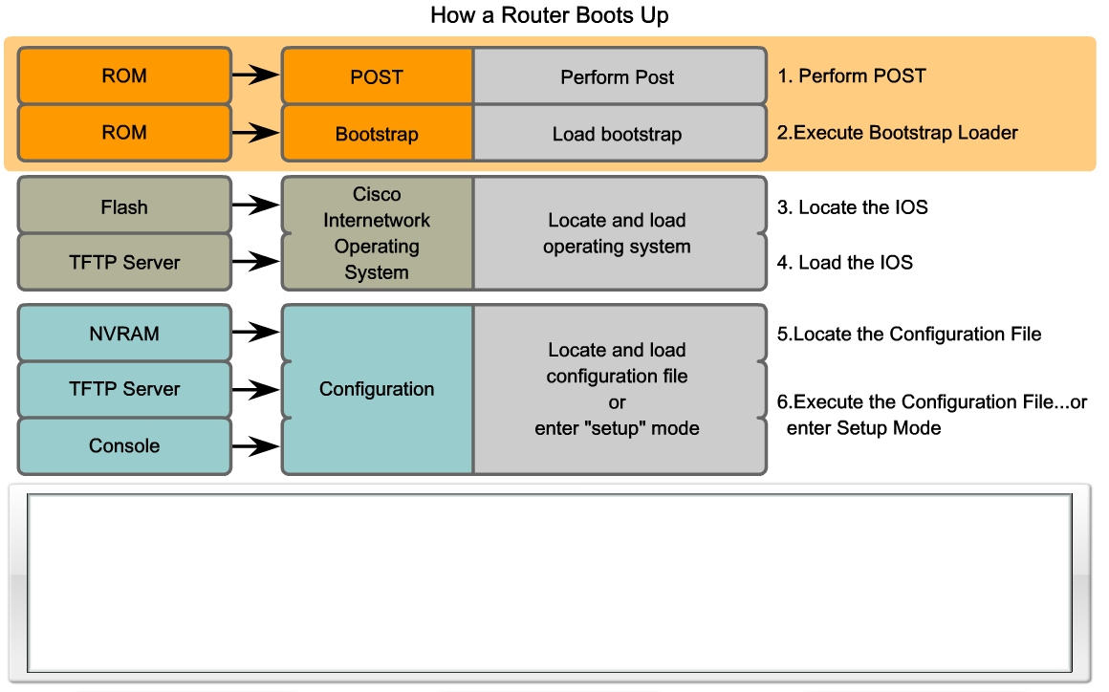
Router Boot-up Router Bootup Process
Perform the POST and load the bootstrap program
Locate and load the Cisco IOS software
Locate and load the startup configuration file or enter setup mode
System Bootstrap, Version 15.0(1r)M15, RELEASE SOFTWARE (fc1)
Technical Support: http://www.cisco.com/techsupport
<output omitted>
Notes:
Section 6.3.2.3

Slide 42
Router Boot-up Show Versions Output
Router# show version
Cisco IOS Software, C1900 Software (C1900-UNIVERSALK9-M), Version 15.2(4)M1, RELEASE SOFTWARE (fc1)
Technical Support: http://www.cisco.com/techsupport
Copyright (c) 1986-2012 by Cisco Systems, Inc.
Compiled Thu 26-Jul-12 19:34 by prod_rel_team
ROM: System Bootstrap, Version 15.0(1r)M15, RELEASE SOFTWARE (fc1)
Router uptime is 10 hours, 9 minutes
System returned to ROM by power-on
System image file is "flash0:c1900-universalk9-mz.SPA.152-4.M1.bin"
Last reload type: Normal Reload
Last reload reason: power-on
<Output omitted>
Cisco CISCO1941/K9 (revision 1.0) with 446464K/77824K bytes of memory.
Processor board ID FTX1636848Z
2 Gigabit Ethernet interfaces
2 Serial(sync/async) interfaces
1 terminal line
DRAM configuration is 64 bits wide with parity disabled.
255K bytes of non-volatile configuration memory.
250880K bytes of ATA System CompactFlash 0 (Read/Write)
<Output omitted>
Technology Package License Information for Module:'c1900'
-----------------------------------------------------------------
Technology Technology-package Technology-package
Current Type Next reboot
------------------------------------------------------------------
ipbase ipbasek9 Permanent ipbasek9
security None None None
data None None None
Configuration register is 0x2142 (will be 0x2102 at next reload)
Router#
Notes:
Section 6.3.2.4

Slide 43
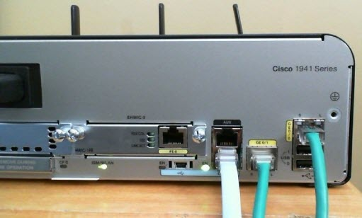
Network Layer Configuring a Cisco Router
Notes:
Section 6.4

Slide 44
Configure Initial Settings Router Configuration Steps
192.168.10.0/24
10.1.1.0/24
PC1
.10
G0/0
.1
209.165.200.224 /30
.10
.1
R1
.225
S0/0/0
.226
R2
.10
.1
G0/1
.1
.10
PC2
192.168.11.0/24
10.1.2.0/24
Router> enable
Router# configure terminal
Enter configuration commands, one per line. End with CNTL/Z.
Router(config)# hostname R1
R1(config)#
Router> en
Router# conf t
Enter configuration commands, one per line. End with CNTL/Z.
Router(config)# ho R1
R2(config)#
OR
R1(config)# enable secret class
R1(config)#
R1(config)# line console 0
R1(config-line)# password cisco
R1(config-line)# login
R1(config-line)# exit
R1(config)#
R1(config)# line vty 0 4
R1(config-line)# password cisco
R1(config-line)# login
R1(config-line)# exit
R1(config)#
R1(config)# service password-encryption
R1(config)#
R1(config)# banner motd #
Enter TEXT message. End with the character '#'.
***********************************************
WARNING: Unauthorized access is prohibited!
***********************************************
#
R1(config)#
R1# copy running-config startup-config
Destination filename [startup-config]?
Building configuration...
[OK]
R1#
Notes:
Section 6.4.1.1

Slide 45
Configure Interfaces Configure LAN Interfaces
192.168.10.0/24
10.1.1.0/24
PC1
.10
G0/0
.1
209.165.200.224 /30
.10
.1
R1
.225
S0/0/0
.226
R2
.10
.1
G0/1
.1
.10
PC2
192.168.11.0/24
10.1.2.0/24
R1# conf t
Enter configuration commands, one per line. End with CNTL/Z.
R1(config)#
R1(config)# interface gigabitethernet 0/0
R1(config-if)# ip address 192.168.10.1 255.255.255.0
R1(config-if)# description Link to LAN-10
R1(config-if)# no shutdown
%LINK-5-CHANGED: Interface GigabitEthernet0/0, changed state to up
%LINEPROTO-5-UPDOWN: Line protocol on Interface GigabitEthernet0/0, changed state to up
R1(config-if)# exit
R1(config)#
R1(config)# int g0/1
R1(config-if)# ip add 192.168.11.1 255.255.255.0
R1(config-if)# des Link to LAN-11
R1(config-if)# no shut
%LINK-5-CHANGED: Interface GigabitEthernet0/1, changed state to up
%LINEPROTO-5-UPDOWN: Line protocol on Interface GigabitEthernet0/1, changed state to up
R1(config-if)# exit
R1(config)#
Notes:
Section 6.4.2.1

Slide 46
Configure Interfaces Verify Interface Configuration
192.168.10.0/24
10.1.1.0/24
PC1
.10
G0/0
.1
209.165.200.224 /30
.10
.1
R1
.225
S0/0/0
.226
R2
.10
.1
G0/1
.1
.10
PC2
192.168.11.0/24
10.1.2.0/24
R1# show ip interface brief
Interface IP-Address OK? Method Status Protocol
GigabitEthernet0/0 192.168.10.1 YES manual up up
GigabitEthernet0/1 192.168.11.1 YES manual up up
Serial0/0/0 209.165.200.225 YES manual up up
Serial0/0/1 unassigned YES NVRAM administratively down down
Vlan1 unassigned YES NVRAM administratively down down
R1#
R1# ping 209.165.200.226
Type escape sequence to abort.
Sending 5, 100-byte ICMP Echos to 209.165.200.226, timeout is 2 seconds:
!!!!!
Success rate is 100 percent (5/5), round-trip min/avg/max = 1/2/9 ms
R1#
Notes:
Section 6.4.2.2

Slide 47
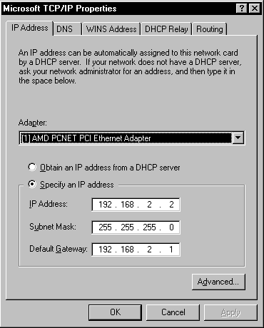
Configuring a Cisco Router Configuring the Default Gateway
Notes:
Section 6.4.3

Slide 48
Configuring the Default Gateway Default Gateway on a Host
PC1
.10
192.168.10.0/24
.1
G0/0
PC2
.10
R1
G0/1
.1
PC1
.10
PC3
.10
192.168.10.0/24
.1
G0/0
.10
192.168.11.0/24
PC2
.11
PC4
R1
G0/1
.1
PC3
.10
.11
192.168.11.0/24
PC4
Notes:
Section 6.4.3.1

Slide 49

Configuring the Default Gateway Default Gateway on a Switch
S1#show running-config
Building configuration...
!
<output omitted>
service password-encryption
!
hostname S1
!
Interface Vlan1
ip address 192.168.10.50
!
ip default-gateway 192.168.10.1
<output omitted>
PC1
.10
192.168.11.0/24
192.168.10.0/24
.1
G0/0
.1
G0/1
.11
S1
R1
S2
PC2
.50
If the default gateway were not configured on S1, response packets from S1 would not be able to reach the administrator at 192.168.11.10. The administrator would not be able to mange the device remotely.
Notes:
Section 6.4.3.2

Slide 50
Network Layer Summary
The network layer, or OSI Layer 3, provides services to allow end devices to exchange data across the network.
The network layer uses four basic processes: IP addressing for end devices, encapsulation, routing, and de-encapsulation.
The Internet is largely based on IPv4, which is still the most widely-used network layer protocol.
An IPv4 packet contains the IP header and the payload.
The IPv6 simplified header offers several advantages over IPv4, including better routing efficiency, simplified extension headers, and capability for per-flow processing.
Notes:
Section 1.5 & 1.5.1

Slide 51
Network Layer Summary
In addition to hierarchical addressing, the network layer is also responsible for routing.
Hosts require a local routing table to ensure that packets are directed to the correct destination network.
The local default route is the route to the default gateway.
The default gateway is the IP address of a router interface connected to the local network.
When a router, such as the default gateway, receives a packet, it examines the destination IP address to determine the destination network.
Notes:
Section 1.5 & 1.5.1

Slide 52
Network Layer Summary
The routing table of a router stores information about directly-connected routes and remote routes to IP networks. If the router has an entry in its routing table for the destination network, the router forwards the packet. If no routing entry exists, the router may forward the packet to its own default route, if one is configured, or it will drop the packet.
Routing table entries can be configured manually on each router to provide static routing or the routers may communicate route information dynamically between each other using a routing protocol.
In order for routers to be reachable, the router interface must be configured.
Notes:
Section 1.5 & 1.5.1

